Slide 1
NE 591: Advanced Reactor Materials
Fall 2021
Dr. Benjamin Beeler

Slide 2
supercritical water cooled reactors

Slide 3
Supercritical Water Reactor (SCWR)
Similar to a traditional light water reactor, but operates at a supercritical pressure
Water heated in the core becomes a supercritical fluid, which can directly be used in a steam turbine
Removes the added step of a heat exchanger, increasing the efficiency of the reactor system

Slide 4
Supercritical water
A supercritical fluid is a substance with a temperature and pressure above its critical point
At such a point, distinct solid and liquid phases do not exist
Critical point of water is 22 MPa and 647 K
Density is highly variable, based on temperature and pressure:
0.78 g/cc @ 25 MPa and 280 C
0.09 g/cc @ 25 MPa and 500 C
these are reasonable inlet/outlet temperatures for SCWR coolant

Slide 5
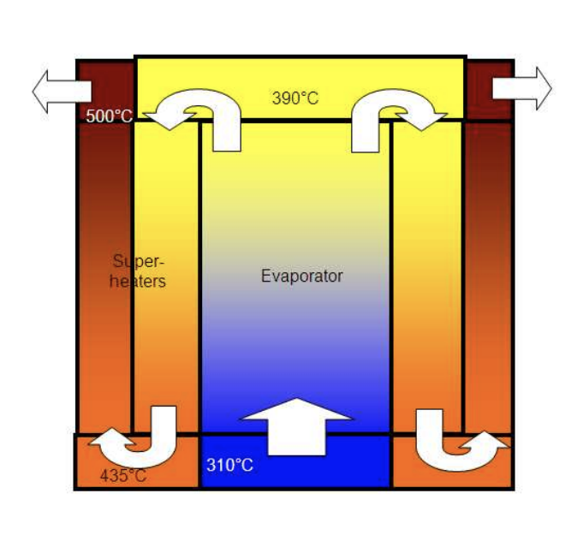
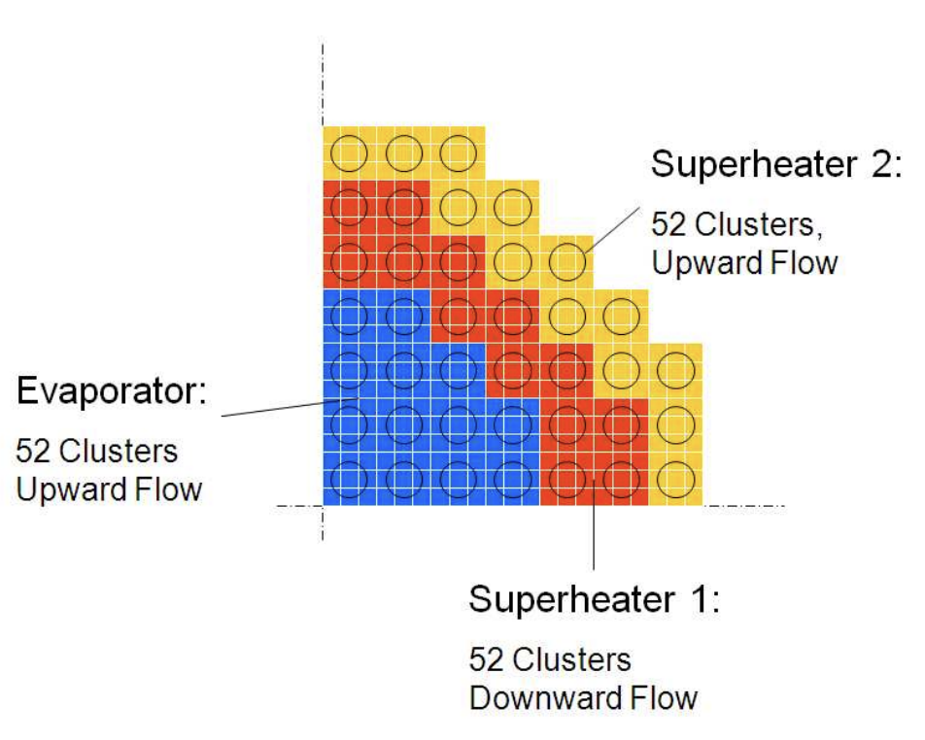
Comparison to LWR
SCWR
coolant in: 280 C
coolant out: 500 C
outlet specific enthalpy: 3150 kJ/kg
three pass coolant
coolant pressure: 22 MPa
LWR
coolant in: 275 C
coolant out: 315 C
outlet specific enthalpy: 200 kJ/kg
one pass coolant
coolant pressure: 15 MPa

Slide 6
Advantages
Supercritical water has excellent heat transfer properties allowing a high power density, a small core, and a small containment structure.
The use of a supercritical Rankine cycle with its typically higher temperatures improves efficiency (would be ~45 % versus ~33 % of current PWR/BWRs).
This higher efficiency would lead to better fuel economy and a lighter fuel load, lessening residual (decay) heat.
SCWR is typically designed as a direct-cycle, whereby steam or hot supercritical water from the core is used directly in a steam turbine with no intermediate heat exchangers, etc.
Water is liquid at room temperature, cheap, non-toxic and transparent, simplifying inspection and repair (compared to liquid metal cooled reactors).
A fast SCWR could be a breeder reactor, like the proposed Clean And Environmentally Safe Advanced Reactor, and could burn the long-lived actinide isotopes.
A heavy-water SCWR could breed fuel from thorium (4x more abundant than uranium), with increased proliferation resistance over plutonium breeders

Slide 7
(Th,U,Pu)O2

Slide 11
Questions?

